Slide 1
Guide to Wireless Communications, Third Edition
Chapter 1
Introduction to Wireless Communications

Slide 2
Objectives
Describe how wireless communications technologies are used today
List various applications of wireless communications technology
Outline the advantages and disadvantages of wireless communications technology
List several types of wireless technologies and their purposes

Slide 3
How Wireless Technology is Used
Wireless: describes all types of devices and technologies not connected by a wire
Wireless communications: transmission of digital data without the use of wires
Various forms of wireless data communications:
  Bluetooth
  WirelessHD
  WiGig
  Satellite
  Cellular
  Wi-Fi-based wireless LANs
  Fixed broadband wireless communications

Slide 4
A Wireless World
Wireless devices
  Distance: up to 330 feet (100 meters)
  Bandwidth: up to 300 Mbps
  Can also include Voice over IP (VoIP)
Wireless network interface card (Wireless NIC)
  Sends and receives data over radio waves
Smartphone: Combination mobile phone and personal digital assistant (PDA)
Radio frequency identification (RFID) tags: small chips containing radio transponders

Slide 5
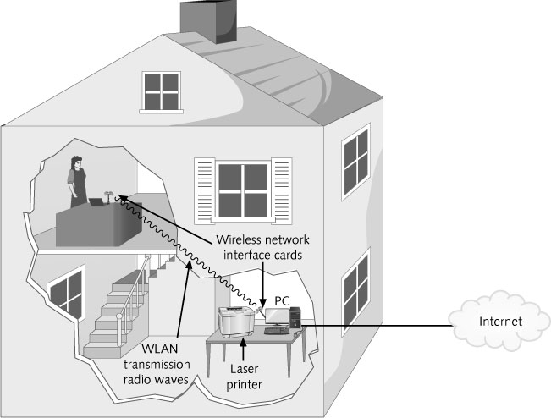
Figure 1-1 Home wireless network (WLAN)

Slide 6
Bluetooth and Other Short-Range Wireless Technologies
Bluetooth
  Wireless standard designed for very short ranges
    Typically a few inches to 33 feet (10 meters)
  Main purpose is to eliminate cables between devices
Bluetooth communicates using small, low-power transceivers called radio modules
Link manager
  Special software that helps identify other Bluetooth devices, create a link between them, and send and receive digital data

Slide 7
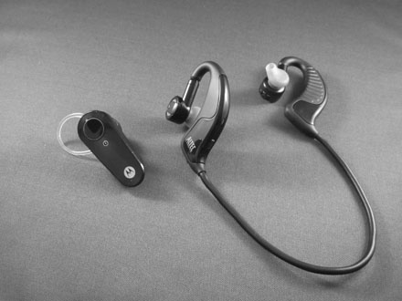
Figure 1-2 Two examples of Bluetooth headsets: mono (left) and stereo (right)

Slide 8
Bluetooth and Other Short-Range Wireless Technologies
Wireless HD and WiGig
  Can transfer video and sound at speeds between 7 Gbps and 10 Gbps using Ultra Wide Band (UWB)
  Distance: up to 10 meters (only in a room with few or no obstacles)
  Greater the distance, the slower the transmission
Piconet
  Wireless personal area network (WPAN)
  Consists of two or more Bluetooth devices that are exchanging data with each other
    Up seven devices can belong to a single WPAN

Slide 9
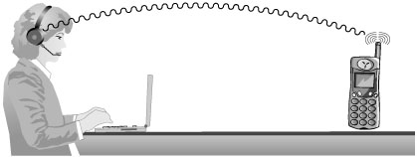
Figure 1-3 Bluetooth network (piconet) or WPAN between
a cordless handset and a headset

Slide 10
Satellite Networks
Used to transmit data over very long distance
Repeater
  Located in the satellite itself
  “Repeats” the same signal to another location down on the surface
  Used to transmit data from one earth station to another
    Transmission time can be up to 250 milliseconds

Slide 11
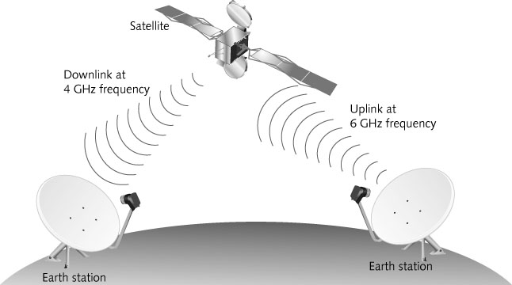
Figure 1-5 Satellite repeating a signal to another Earth station

Slide 12
Cellular Networks
Modern cellular telephone network
  Built around the concept of low-power transmitters
  With each “cell” handling a number of users
  Transmission towers are spread throughout a geographical area
  The same radio frequency channels can be reused by another tower
    Located a few miles away to avoid interference
    Maximizes the use of a limited range of frequency channels

Slide 13
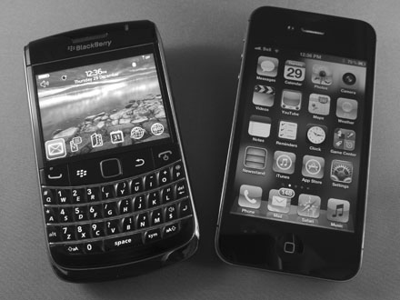
Figure 1-6 Smartphones - Blackberry Bold (left) and Apple iPhone (right)

Slide 14
Cellular Networks
4G (fourth generation) technology
  Uses 100% digital transmission for both voice and data
  Transmission speed
    Over 150 Mbps when stationary
    45 Mbps for slow-moving pedestrians
    20 Mbps in a fast moving vehicle
3G (third generation) technology
  Has a theoretical maximum data transmission rate of up to 21 Mbps
  Realistic speeds are between 3 to 11 Mbps

Slide 15
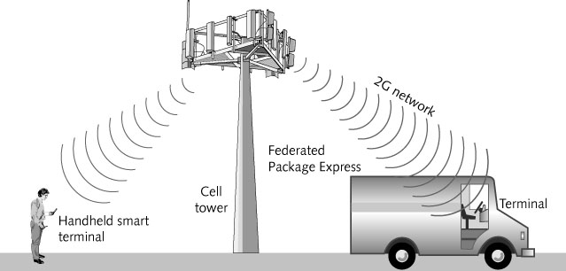
Figure 1-7 Digital cellular network

Slide 16
Wireless Local Area Networks
Wireless Local Area Network (WLAN)
  Extension of a wired LAN
    Connecting to it through a device called a wireless access point
Access point (AP or wireless AP)
  Relays data signals among all of the devices on the wired network
Each computer on the WLAN has a wireless network interface card (NIC)
  Has an antenna built into it

Slide 17
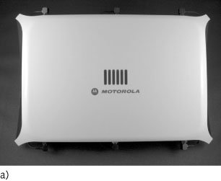
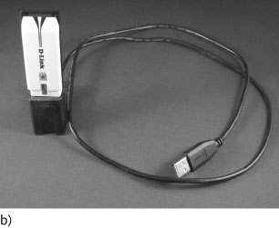
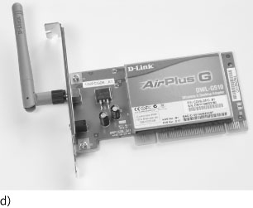
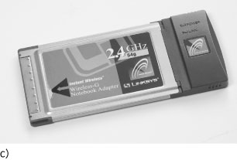
Figure 1-8 Clockwise from top left: a) access point with built-in antennas,
b) USB Wireless NIC, c) PCMCIA, and d) PCI Wireless NICs

Slide 18
Wireless Local Area Networks
Institute of Electrical and Electronic Engineers (IEEE) standards
  Established a series WLAN standards
  Most recent IEEE 802.11n-2009 (more commonly known as IEEE 802.11n)
    Provides for transmission speeds of up to 600 Mbps and covers distances up to 375 feet

Slide 19
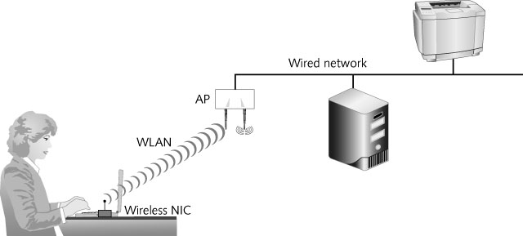
Figure 1-10 Office WLAN

Slide 20
Fixed Broadband Wireless
Integrated Services Digital Networks (ISDN)
  Transmits at up to 256 Kbps over regular phone lines
T1 lines
  Transmit at 1.544 Mbps
  Very costly option
Cable modems
  Generally only available in residential areas
Digital subscriber lines (DSL)
  Use either regular or special telephone lines
  Speed is dependent on distance between FPE’s main office and nearest telephone switching office

Slide 21
Fixed Broadband Wireless
Wireless metropolitan area network (WMAN)
  Covers a distance of up to 25 miles
  Based on the IEEE 802.16 WIMAX Fixed Broadband Wireless standard
  Uses radio waves and small custom antennas on the roof of each building in WMAN
  Transmission speeds
    75 Mbps at distances of up to 4 miles (6.4 km)
    17 to 50 Mbps at distances over 6 miles (10 km)
  Newer versions of IEEE 802.16m standard will be able to achieve average speeds up to 100 Mbps

Slide 22
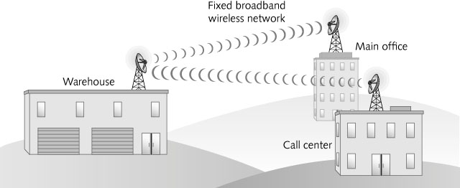
Figure 1-11 IEEE 802.16 wireless metropolitan area network (WMAN)

Slide 23
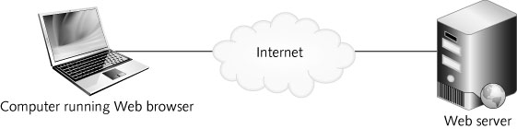
Wireless Wide Area Network
Hypertext Markup Language (HTML)
  Standard language for displaying content from the Internet
Figure 1-12 Browsing the World Wide Web on a PC

Slide 24
Wireless Wide Area Network
Microbrowser
  Miniaturized version of a Web browser
  May be found on older cellular phones
Wireless Application Protocol version 2.0 (WAP2)
  Provides a standard way to transmit, format, and display Internet data
    For small wireless devices such as cell phones
  Compatible with HTTP but uses earlier, simpler version (1.1) of HTTP
  Most smartphones are equipped with WAP2 browsers, which are used when they cannot access high-speed digital cellular services

Slide 25
Wireless Wide Area Network
J2ME (Java 2 Micro Edition) – programming language that allows most newer cell phones to display text, graphics, and limited animations on small screens
Wireless Wide Area Network (WWAN)
  Enables employees to access corporate data and applications from virtually anywhere using cellular phone technologies

Slide 26
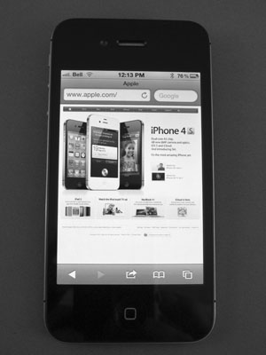
Figure 1-13 Displaying Web content on a smartphone

Slide 27
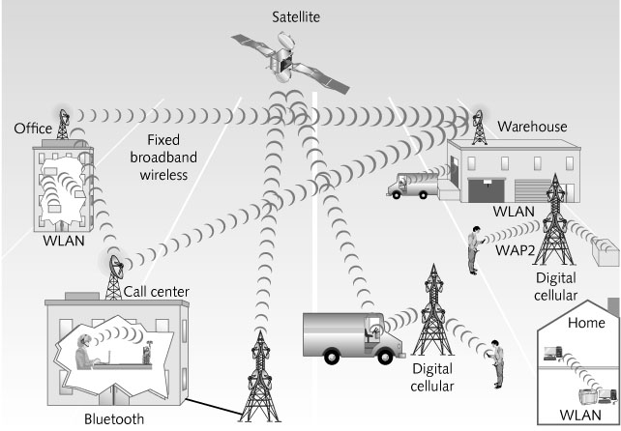
The Wireless Landscape
Wireless communications
  Has become a standard means of communication for people in many occupations and circumstances
Figure 1-14 Wireless communications

Slide 28
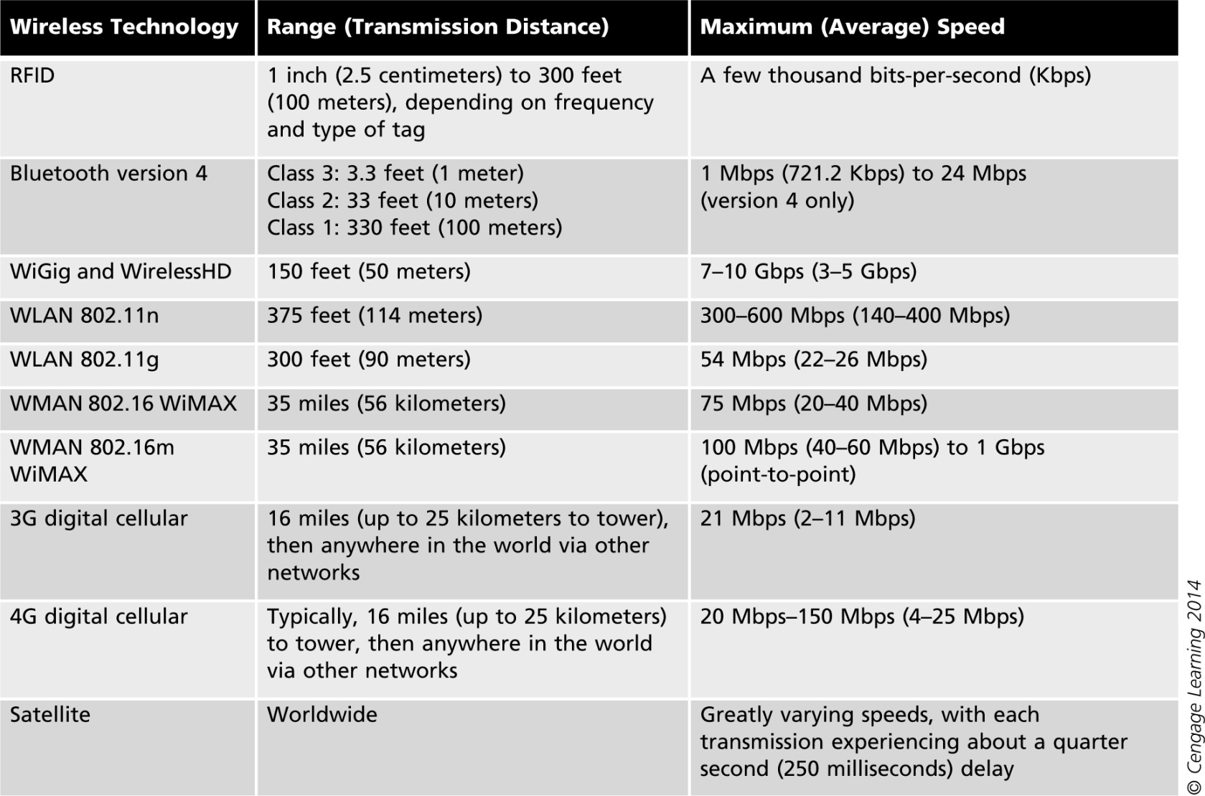
Table 1-1 Wireless data communications technologies

Slide 29
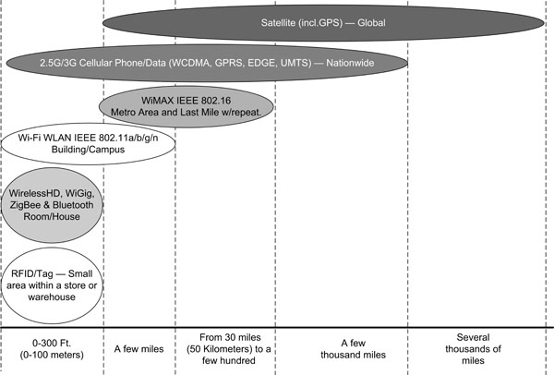
Figure 1-15 Comparing wireless communications technologies

Slide 30
The Wireless Landscape
Speeds of wireless networks vary greatly depending on:
  Number of users connected
  Amount of data traffic
  Amount of interference present at the time
  Other factors that will be discussed in later chapters
Job market will increase for:
  Wireless engineers
  Wireless local area network managers
  Wireless technical support personnel

Slide 31
Digital Convergence
Digital convergence
  Refers to the power of digital devices to combine voice, video, and text-processing capabilities
    As well as to be connected to business and home networks and to the Internet
  Same concept applies to the development of VoIP networks
    Use the same protocols and media that once only carried data
  Wireless technologies are used to fulfill many daily activities

Slide 32
Wireless Applications
Main areas
  Education
  Home entertainment and Home control systems
  Health Care
  Government and Military
  Office environments
  Event management
  Travel
  Construction and warehouse management
  Environmental research
  Industrial control

Slide 33
Education
Ideal application for colleges and schools
Instructors can create classroom resources in their home or school office and easily connect to campus network in the classroom
It frees students from having to go to a specific computer lab or the library
  To get on the school’s computer network
Wireless technology translates into a cost savings for colleges
  Traditional classrooms become computer labs without the expense of additional wiring

Slide 34
Home Entertainment
Wireless communication
  Enables people to download, distribute, and control all forms of digital entertainment from anywhere in the house
  Examples:
    Wireless speakers, media players, game consoles, DVD players, televisions, digital video recorders (DVRs), and multimedia personal computers

Slide 35
Home Control Systems
Manufacturers are creating wireless systems that enable us to:
  Control lights, heating, ventilation, air conditioning, drapes, alarms, door locks, and home appliances
  Can control from locations throughout the house or even from smartphones or tablets outside the home
Several systems use the ZigBee Alliance communications protocols and the IEEE 802.15.4 standard

Slide 36
Health Care
Administering correct medication in a hospital setting
  A major concern for the health care industry
Wireless point-of-care computer systems
  Allow medical staff to access and update patient records immediately
Many hospitals use portable devices with barcode scanners or RFID and a wireless connection
Patients may have a barcoded or RFID-enabled armband that can be scanned to access records
System immediately verifies correct medication

Slide 37
Government
Wireless communication
  Lets residents, city employees, contractors, and utility staff collect and transmit data to central databases
  Examples:
    Building inspectors can update permit data while at the construction site
    City employees can locate and monitor municipal vehicles
  Delivers broadband connectivity to schools, libraries, and government buildings
  Provides free Internet access to residents and attracts visitors and businesspeople

Slide 38
Military
Latest devices allow military personnel in the field to:
  Use voice and the Internet
  Receive and transmit full-motion video
  Maneuver remote control survey drones
  Use digital battlefield maps
  Many other applications

Slide 39
Office Environments
Employees in all lines of work no longer have to be away from the data they need
  To help them make decisions
Wireless technologies allow businesses to create an office where the traditional infrastructure doesn’t exist
During office renovations or reorganization
  Employees can move to another location and be connected immediately

Slide 40
Event Management
Wireless networks
  Help identify a stolen or counterfeit ticket
  Can also give a real-time look at traffic flow
    Use to determine where staff might be needed
  In-progress game statistics are available to any fan in the stadium with a wireless device

Slide 41
Travel
Wireless global positioning systems (GPS)
  Tie into emergency roadside assistance services
  OnStar roadside assistance is an example
Satellite radio
  Transmits over 150 music and talk stations
Airport terminals are offering wireless technologies to passengers
Airplanes themselves are being equipped with wireless data access
City transit systems are also “going wireless”

Slide 42
Construction
Wireless communications
  Send information from the job site to the main office
    Tardy subcontractor or problems with materials
  Alert when maintenance operations need to be performed on equipment
    Bulldozers and earth graders are being turned into “smart” equipment
    Exact location of dig coordinates can be transmitted to a terminal on the bulldozer
    Track engine hours and equipment location

Slide 43
Warehouse Management
Implementing wireless technology is key for many warehouse operations
Warehouse management system (WMS) software
  Used to manage all of the activities from receiving through shipping
In the near future
  Most of the bar code functions, including inventory counting, will be replaced by RFID tags
    Will eliminate the need for printing and affixing labels

Slide 44
Environmental Research
Scientists are now using small, battery- or solar-cell-powered WLAN sensors
  In places that were previously difficult to access and monitor
  Considered a major breakthrough in many scientific fields
    Has helped collect data that used to be very difficult or impossible to collect and record

Slide 45
Industrial Control
Motes
  Remote sensors
  Can connect to a WLAN
    Then collect data and transmit it to a central location
Manufacturing managers can monitor equipment from an office
  Problems can be detected instantly
Technicians in a control room can monitor status of every machine or device
  Dispatch a technician when necessary

Slide 46
Wireless Advantages and Disadvantages
As with any new technology, wireless communications offers both advantages and disadvantages

Slide 47
Advantages of Wireless Networking
Mobility
  Freedom to move about without being tethered by wires
  Permits many industries to shift toward an increasingly mobile workforce
  Creating “flatter” organizations with fewer management levels between top executives and regular employees
Easier and less expensive installation
  Installing network cabling in older buildings can be a difficult, slow, and costly task
  Makes it easier for any office to be modified with new cubicles or furniture

Slide 48
Advantages of Wireless Networking
Increased reliability
  Network cable failures may be the most common source of network problems
Disaster recovery
  In the event of a disaster, managers can quickly relocate the office
  Some planners keep laptop computers with wireless NICs and access points in reserve
Future Applications
  Every day, a new application for wireless data transmission is thought of or implemented

Slide 49
Disadvantages of Wireless Networking
Radio signal interference
  The potential for two signals to interfere exists
  Solution: locate source of interference and eliminate it
Security
  It is possible for an intruder to be lurking outdoors with a notebook computer and wireless NIC
    With the intent of intercepting the signals from a nearby wireless network
  Some wireless technologies can provide added levels of security
  Network managers can limit access

Slide 50
Disadvantages of Wireless Networking
Health risks
  High levels of RF can produce biological damage through heating effects
    Wireless devices emit low levels of RF while being used
    No clear picture of the biological effects of this type of radiation has been found to date
  Science today does not yet permit anyone to draw a definitive conclusion on the safety of wireless mobile devices
    Be aware of the possibility and monitor ongoing scientific research

Slide 51
Summary
Wireless communications have become commonplace
Wireless networks and devices are found in all circles of life today
Wireless wide area networks will enable companies of all sizes to interconnect their offices
  Without the high cost charged by telephone carriers for their landline connections
WLAN applications are found in a wide variety of industries and organizations

Slide 52
Summary
Remote sensors capable of communicating using wireless technologies
  Used in large manufacturing facilities to monitor equipment and for scientific research
Wireless communication advantages
  Mobility
  Easier and less expensive installation
  Increased network reliability
  Support for disaster recovery

Slide 53
Summary
Wireless communication disadvantages
  Radio signal interference
  Security issues
  Health risks

